Slide 1
Introduction to SAP S/4HANA
Next Generation Business Suite

Slide 2
Global Bike 4.1
Last Update: June 2022
S/4HANA 2020
Fiori 3.0
none

Slide 3
Babett Ruß
Beginner to Advanced

Slide 4
At the completion of this module, you will:
Describe the SAP vision of the Intelligent Enterprise
Be able explain the basic concepts of an Enterprise Resource Planning solution based on the SAP S/4HANA system.
Explain how to use the SAP Fiori User Interface to interact with the S/4HANA system

Slide 5
Agenda
SAP – The Intelligent Enterprise
Fast Facts about SAP S/4HANA
What´s New?
Transition to SAP S/4HANA

Slide 6
SAP – The Intelligent Enterprise
Market leader in enterprise application software
One of the world largest independent software manufacturer
400,000 satisfied Customers in 190 countries
SAP enables companies to
Streamline processes
Use live data
Predict customer trends
Connect entire businesses
Intelligence will reinvent industries and change business forever
Best-run technologies and solutions
deployed end-to-end for your industry.

Slide 7
SAP – Run Simple
A Short History
SAP joins the Internet
SAP R/3 can now be used online
2002
30th Birthday of SAP
3rd largest independent software provider
1995/96
Development SAP R/3
SAP presents at the CeBIT Hanover
1993/94
Partnership with Microsoft → connecting SAP R/3 with Windows NT operating system
IBM Corporation is now using SAP R/3
1986-89
1981/82
Introduction SAP R/2
1972
Foundation of SAP
Development of real-time data application software

Slide 8










SAP – Run Simple
A Short History
2015
Implementation of 1st SAP
in-memory computing product
→ SAP HANA platform
Data access possible in seconds
2013
SAP Business Suite moves to SAP HANA → fastest growing product in history of enterprise software
2011
2009
Launching Business Suite 7 → optimization of business performance
→ reduce IT costs
2005/06
Announcment of release SAP ERP

Slide 9
Agenda
SAP – The Intelligent Enterprise
Fast Facts about SAP S/4HANA
What´s New?
Transition to SAP S/4HANA

Slide 10
What´s New?
SAP S/4HANA …
… is the next generation Business Suite
… is the biggest innovation since SAP R/3
… connects people, business networks and devices
… works in real time
… represents efficiency, simplicity and innovation
… master data is managed centrally, for example partners, customers and vendors
1979
R/2
1992
R/3
2004
ERP
2015
S/4HANA

Slide 11
Fast Facts about SAP S/4HANA Enterprise Resource Planning (SAP ERP)
Enables a company to support and optimize its business processes
Helps the organization run smoothly
Real-time environment, Scalable and flexible
Collections of logically related transactions within
identifiable business functions
Buy (MM)
Track (CO)
Sell (SD)
People (HCM)
Make (PP)
Maintain (EAM)
Track (FI)
Store (WM)
Projekt (PS)
Services (CS)

Slide 12
Fast Facts about SAP S/4HANA Data Types in ERP Systems
? | ? | ?
… | … | …

Slide 13
Fast Facts about SAP S/4HANA Data Types in ERP Systems
Organizational Data | Master Data | Transaction Data
Company Code | Person | Purchase Order
Plant | Material | Invoice
Storage Location | Customer | Quotation
Distribution Channel | Vendor | Sales Order
Purchasing Organization | Work Centre | Transportation Order
… | … | …

Slide 14
Fast Facts about SAP S/4HANA Organizational Unit
SAP Terminology:
Enterprise
Client
Company Code
Plant
Sales Organization
Division
Storage Location
Company
Subsidiary
Plant
Sales Organization
Sales Organization
Storage Location
Department
Division
Business Area

Slide 15
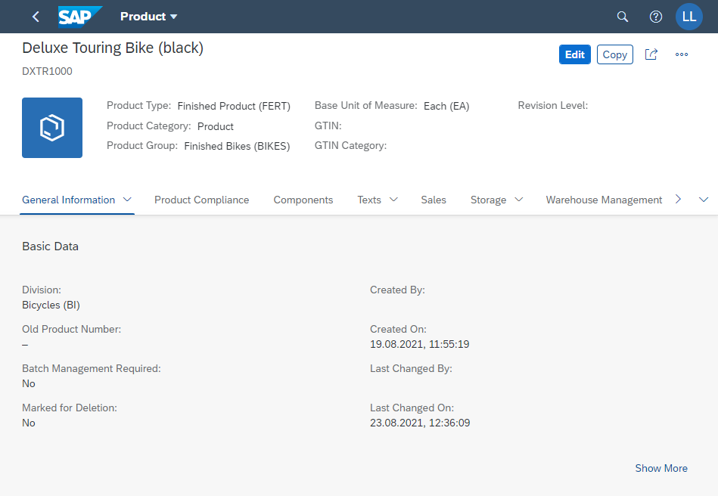
Fast Facts about SAP S/4HANA Master Data
Stored for a long time and seldom changed
Represent logically grouped data like:
Customer Master
Material Master
Vendor Master
General Ledger accounts

Slide 16
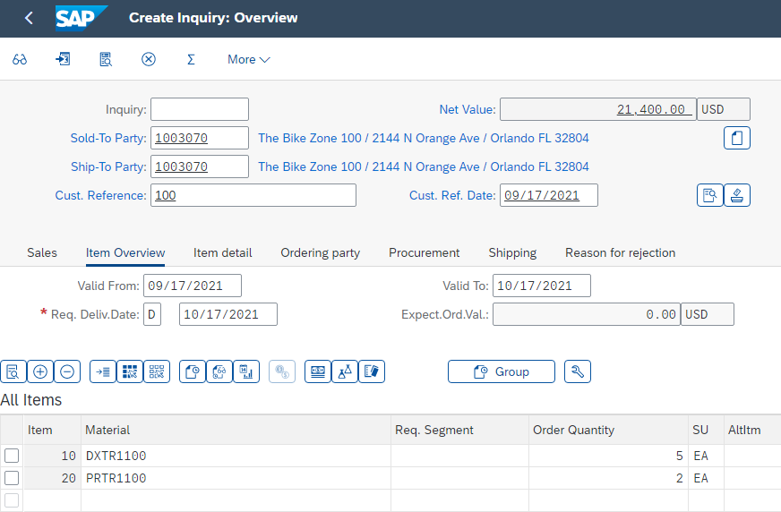
Fast Facts about SAP S/4HANA Transaction Data
Transaction data is the system record of business event.
Depending on the business event, different master data and organizational data will be referenced
For example, during a sales order business event, the following data is stored
Organizational level: client, company code, sales organization
Master data: customer, material, pricing (condition)
Situational data: date, time, person, amount

Slide 17
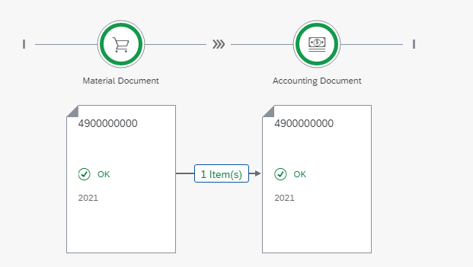

Fast Facts about SAP S/4HANA Documents
Transactions are data sets that are generated if a business transaction was executed.
Is a record of the business transaction
Includes all relevant predefined information from the master data and organizational entities
Example:
Sales Document
Purchasing Document
Material Document
Accounting Document
Document Flow
The document flow as well as the order status allow the setting of the status at any point in time
SAP revises the status every time a change in a document takes place

Slide 18
Fast Facts about SAP S/4HANA Digital Transformation - Why?
Changing the way of life
Empowered & Informed Customer
Simulation
Forecasting
Contact to the companies by social media etc.
Customer
Research
New possibilities
Drivers of Change
IoT
Companies
Changing customer expectations
Technology
Cloud
New organization units
Big Data
Mobility

Slide 19
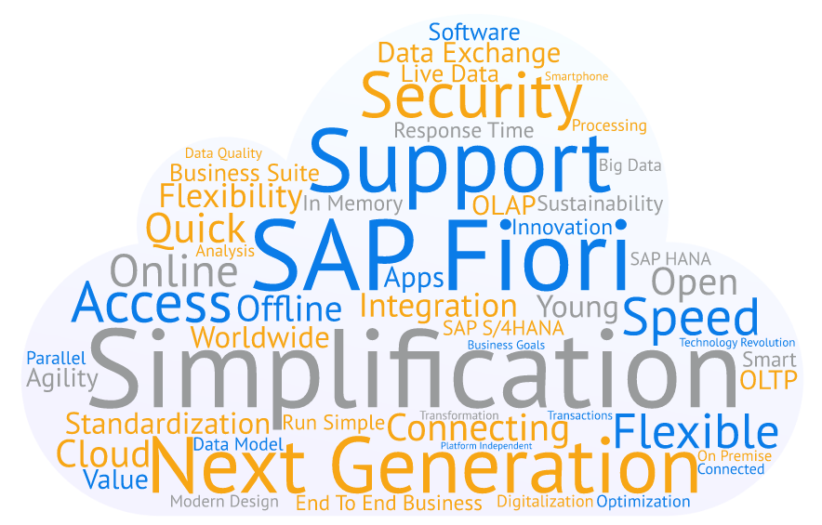
Fast Facts about SAP S/4HANA
S/4HANA is the digital core of the company
that enables digital transformation.

Slide 20






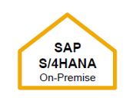
Fast Facts about SAP S/4HANA
Back to Standard
Modifications
Cloud
ERP
Simpli- fication
On-Premise
Any DB

Slide 21
SAP S/4HANA Architecture

Slide 22
Fast Facts about SAP S/4HANA On-Premise vs. Cloud
SAP S/4HANA …
… Choose between Cloud and On-Premises
Cloud and On-Premise can be used hybridly
without losing the company´s integration
Possible migration of SAP Business Suite customers
SAP Fiori
SAP S/4HANA Core
SAP HANA

Slide 23
Fast Facts about SAP S/4HANA On-Premise vs. Cloud
Subscription Licensing
→ Deployment in the private cloud, maintained by SAP
SAP provides system and controls maintenance
Automatic participation in quarterly innovation upgrades
In-App extensibility with limited ABAP
Current release cycles
SAP ERP embedded
Traditional licensing
→ Traditional licensing with customer control of deployment and maintenance
Private control of deployment and maintenance
Hardware at companies location
Privately controlled data
Fewer release cycles
Individual requirements possible
Traditional ABAP extensibility up to core modification

Slide 24
Fast Facts about SAP S/4HANA Optimization Levers
What needs to be optimized?
Efficiency
Acclerate execution
Automate process steps
Digital out-tasking
Effectiveness
Speed up action
De-layer process
Raise process intelligence
Agility
Process flexibility
Organizational agility
Assimilate process innovation

Slide 25

Fast Facts about SAP S/4HANA Optimization Levers - How?
Optimization levers applied on … Market to the Segment of One
Business | IT
Real-time performance and information Real-time operation and collaboration Data-driven market Cross-channel integration Merge structured and unstructured data | Removing of locking issues Simple data model Removing of indices Faster handling of more numbers of documents Higher volume of customer data Easy maintenance
Efficiency
Effectiveness
Agility

Slide 26
Fast Facts about SAP S/4HANA Optimization Levers - How?
Optimization levers applied on … Real Time Inventory Management
Business | IT
Real-time inventory management Real-time product availability Increased inventory turnover Reduced batch size Faster operational reporting Fewer stockouts Better order fulfillment Lower safety stocks | No separation of data entities from different tables Parallel postings and processes Faster reporting Frequent updates 1 document table instead of 26 aggregate tables Reduced memory footprint New data-based architecture
Efficiency
Effectiveness
Agility

Slide 27
Fast Facts about SAP S/4HANA Optimization Levers - How?
Optimization levers applied on … Accelerated Material Requirements Planning
Business | IT
Real-time data MRP run on request System-based recommendations for faster decision making State-of-the-art cockpit Costs savings Improved just-in-time delivery Increased inventory turnover | Single source of truth Merging of OLAP & OLTP Better system handling Opportunity to run MRP centrally Better customer solutions Reduced data footprint Better system performance
Efficiency
Effectiveness
Agility

Slide 28
Agenda
SAP – The Intelligent Enterprise
Fast Facts about SAP S/4HANA
What´s New?
Transition to SAP S/4HANA

Slide 29
What´s New?
SAP S/4HANA …
… works with in-memory
… has a new and modern design
… works with new technology
In-Memory Database
Column store
In-memory processing
Compression
Parallel processing
Fiori
Hardware independence
Mobile devices
OLAP+OLTP together
Real-time analytics on current data
Consolidated forecasts including actual and planned cash data

Slide 30
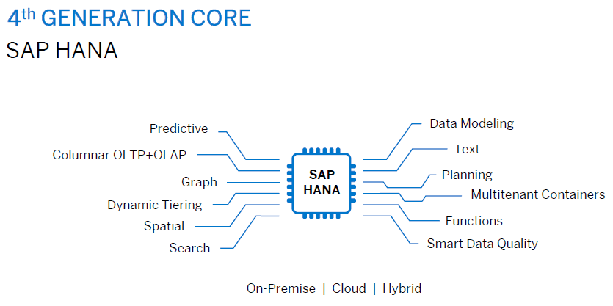
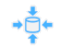
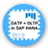

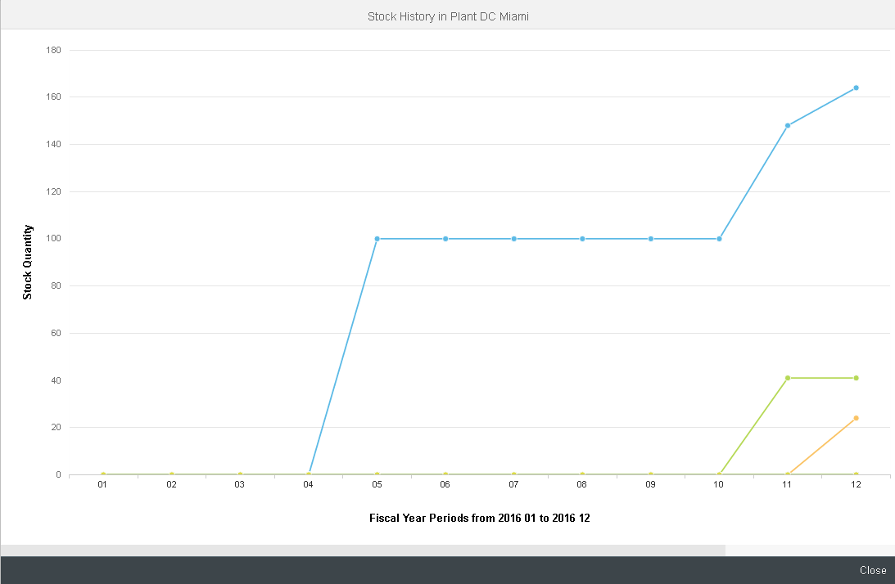
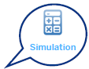

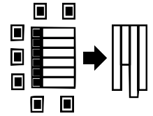
What´s New? Innovation & Simplification
Compression
SAP HANA
Real-Time Simplifica-tion
OLAP+OLTP together
SAP FIORI
Any Attribute as an Index

Slide 31
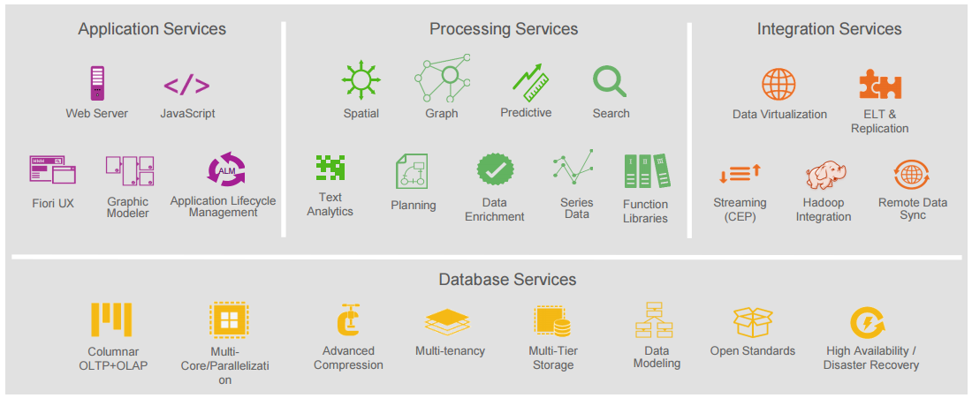
What´s New? SAP HANA
SAP HANA is an in-memory database that allows you to process data very fast
But SAP HANA can do way more with its different processing engines
SAP HANA
Real-Time Simplification
SAP FIORI

Slide 32
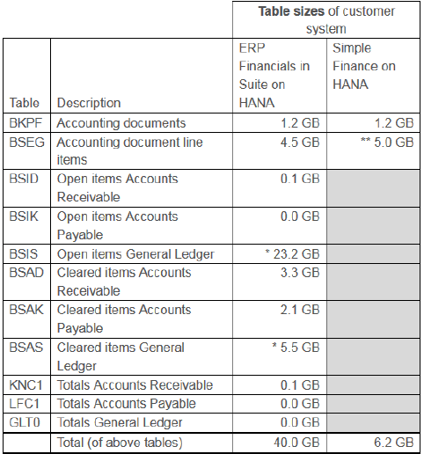
What´s New? Real Time Simplification
Example of data compression
Traditional Database Architecture | S/4HANA Data Model Principles
Normalized data modeling third normal form Avoidance of unwanted redundancies Avoidance of inconsistencies and anomalies Disadvantages Frequent use of redundant data to increase the performance of e.g. data aggregation Higher effort to update redundant data | Storage of data in denormalized form Single source of data No longer need for redundant data storage for tasks such as aggregation Processing of aggregation and analytics on the fly Check for inconsistencies and anomalies due to denormaliza-tion no longer a critical task
Traditional DB
593 GB
on HANA
118,6 GB
S/4 HANA
42,4 GB
A typical booking transaction addressed 15 tables.
→ Now it only impacts 4 tables.
BKPF
BSEG
BSEG
BSEG
BSIS
BSIS
BSIK
BSET
LFC1
GLT0
SAP HANA
Real-Time Simplification
GLT0
GLT0
COBK
COEP
COSP
SAP FIORI

Slide 33

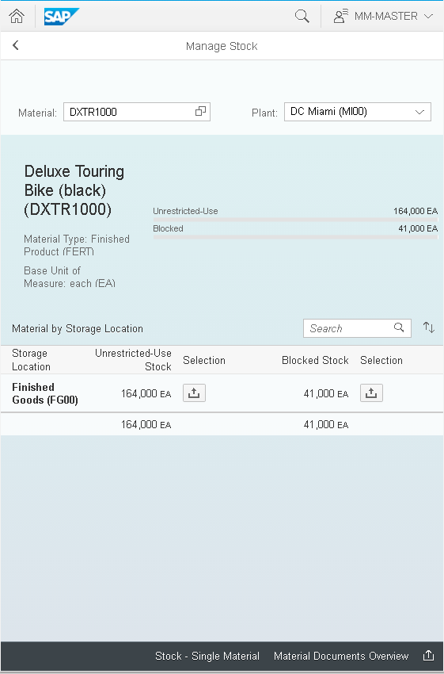

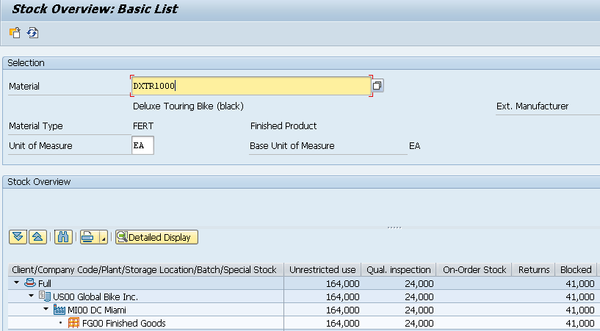
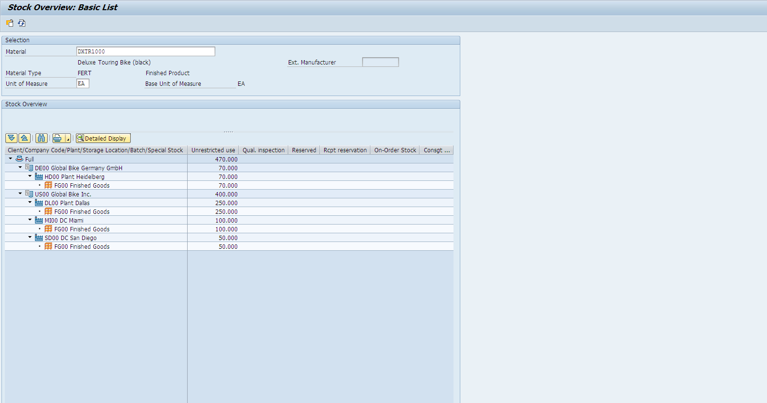
What´s New? SAP FIORI
SAP S/4HANA provides SAP Fiori user interface and experience
Independent of hardware
Real-time
SAP HANA
Real-Time Simplification
SAP FIORI

Slide 34
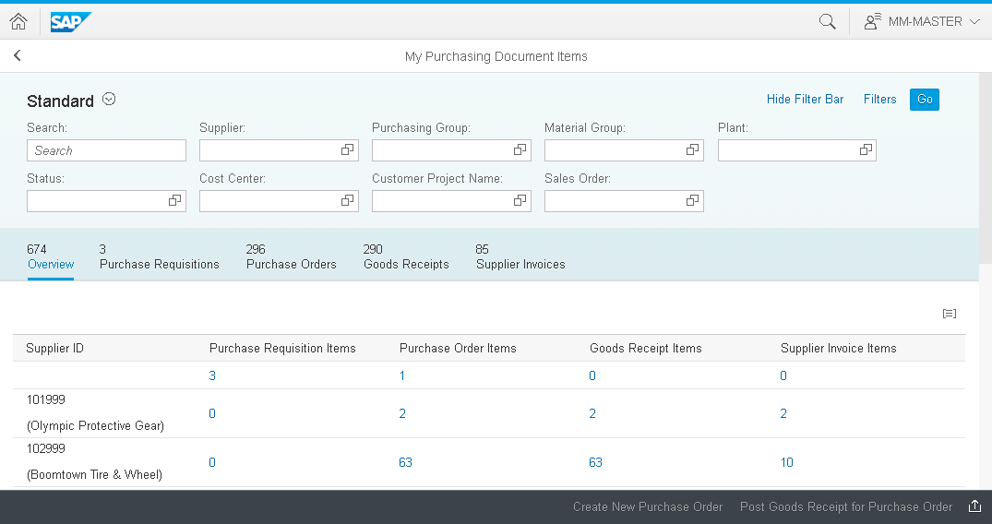
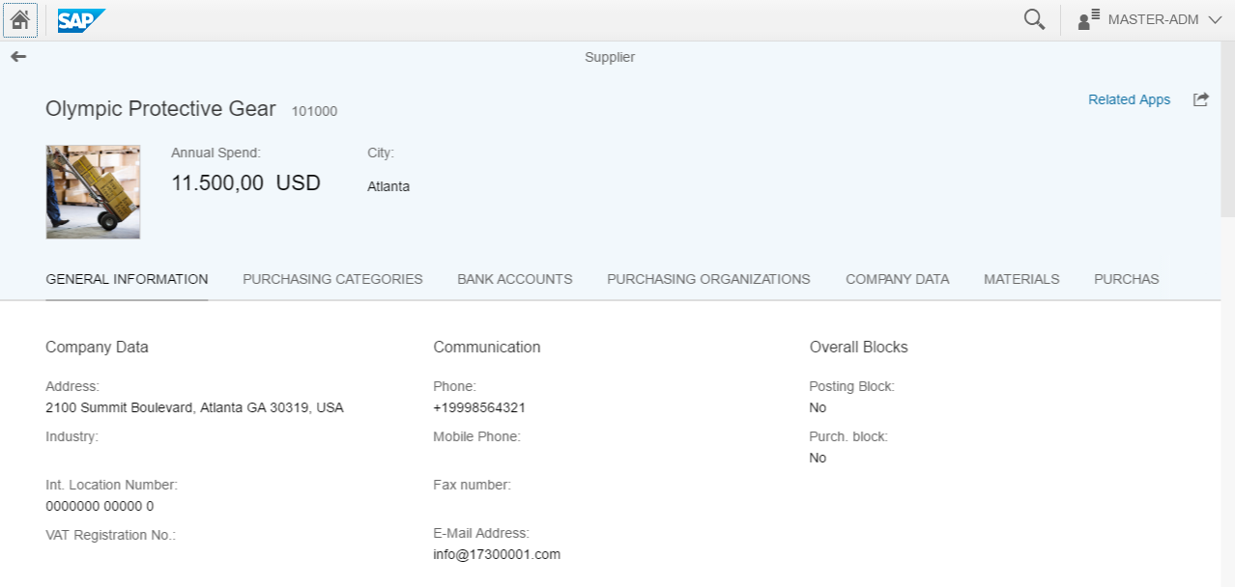
What´s New? SAP FIORI
SAP Fiori offers three application types:
Transactional Apps:
Access to tasks like create, change or display process with guided navigation
Analytical Apps:
Visual overview about business data
Factsheet:
View essential information about objects and contextual navigation between related objects
SAP HANA
Real-Time Simplification
SAP FIORI

Slide 35
Agenda
SAP – The Intelligent Enterprise
Fast Facts about SAP S/4HANA
What´s New?
Transition to SAP S/4HANA

Slide 36
Transition to SAP S/4HANA
ERP System
Non-SAP System
New
Implementation
ERP System
Non-SAP System
System
Conversion
ERP System
Non-SAP System
Landscape
Transformation

Slide 37
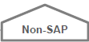
Transition to SAP S/4HANA New Implementation
Installation SAP S/4HANA
Initial data load from source system
Tools used are: SAP Data Services (SAP DS) for On-Premise
SAP Landscape Transformation (SAP LT) for Cloud
Scenario description
New implementation of SAP S/4HANA
e.g. for customers migrating a legacy system
(also known as “greenfield” approach)
Benefits for the customer
Reengineering and process simplification based on
ready-to-run business processes
Predefined migration objects & best practices available
with guided configuration
Reduce time to value and customer total cost of ownership
Rapid adoption of new innovations
Project duration parameters
Number of data migration objects (Material, Customer, Vendor, etc.)
Volume and complexity per data migration object
Legacy
Any customer
legacy system
SAP Fiori
SAP S/4HANA Core
SAP HANA

Slide 38

Transition to SAP S/4HANA System Conversion
Check add-ons and other solutions to ensure compatibility
Check components and customer code to validate further prerequisites
Run the conversion
Scenario description
Customers who want to convert their current system
into an SAP S/4HANA system
Database, SAP NetWeaver and application transition
in one step
Benefits for the customer
Migration without reimplementation
No disruption for existing business processes
Reevaluation of customization and existing process flows
Project duration parameters
Technical: Number of systems and source database size
Functional: Number of company codes, ledgers,
operating concerns, etc.
SAP GUI
SAP ERP Core
Any DB / SAP HANA
(SAP GUI) / SAP Fiori
SAP S/4HANA Core
SAP HANA

Slide 39
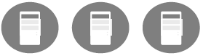
Transition to SAP S/4HANA Landscape Transformation
Scenario description
Customers who want to consolidate their landscape or to
selectively transform data into an SAP S/4HANA system
Benefits for the customer
Selective data transformation allows a phased approach,
focusing on parts of the business with highest ROI and
lowest TCO
System and landscape consolidation with harmonized/simplified
processes and unified master data lead to lower TCO
Project duration parameters
General: Depending on the selected sub-scenario
(System Consolidation, Selective Migration, Central Finance)
Specific: Number of systems to be consolidated,
volume of selected data
Consolidation: Consolidate clients from different source systems into one new or existing SAP S/4HANA system using the SAP Landscape Transformation (SAP LT) tool.
Selective Data Transformation:Migration of selected SAP applications (e.g. Central Finance) Tool used: SAP Landscape Transformation
(SAP GUI) / SAP Fiori
SAP S/4HANA Core
SAP HANA

